Slide 1
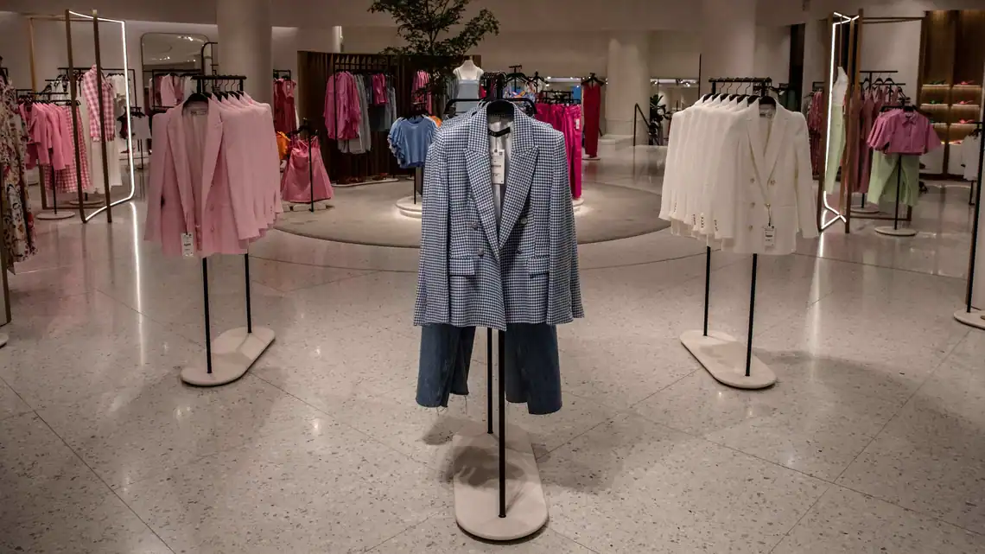
Topic:-Business Proposal For Opening Cloth Shop
Name:-Jadhav Rajvardhan Vijay.
Roll N0:-13.
Subject:-PBC.
Prn:-201105014.

Slide 2
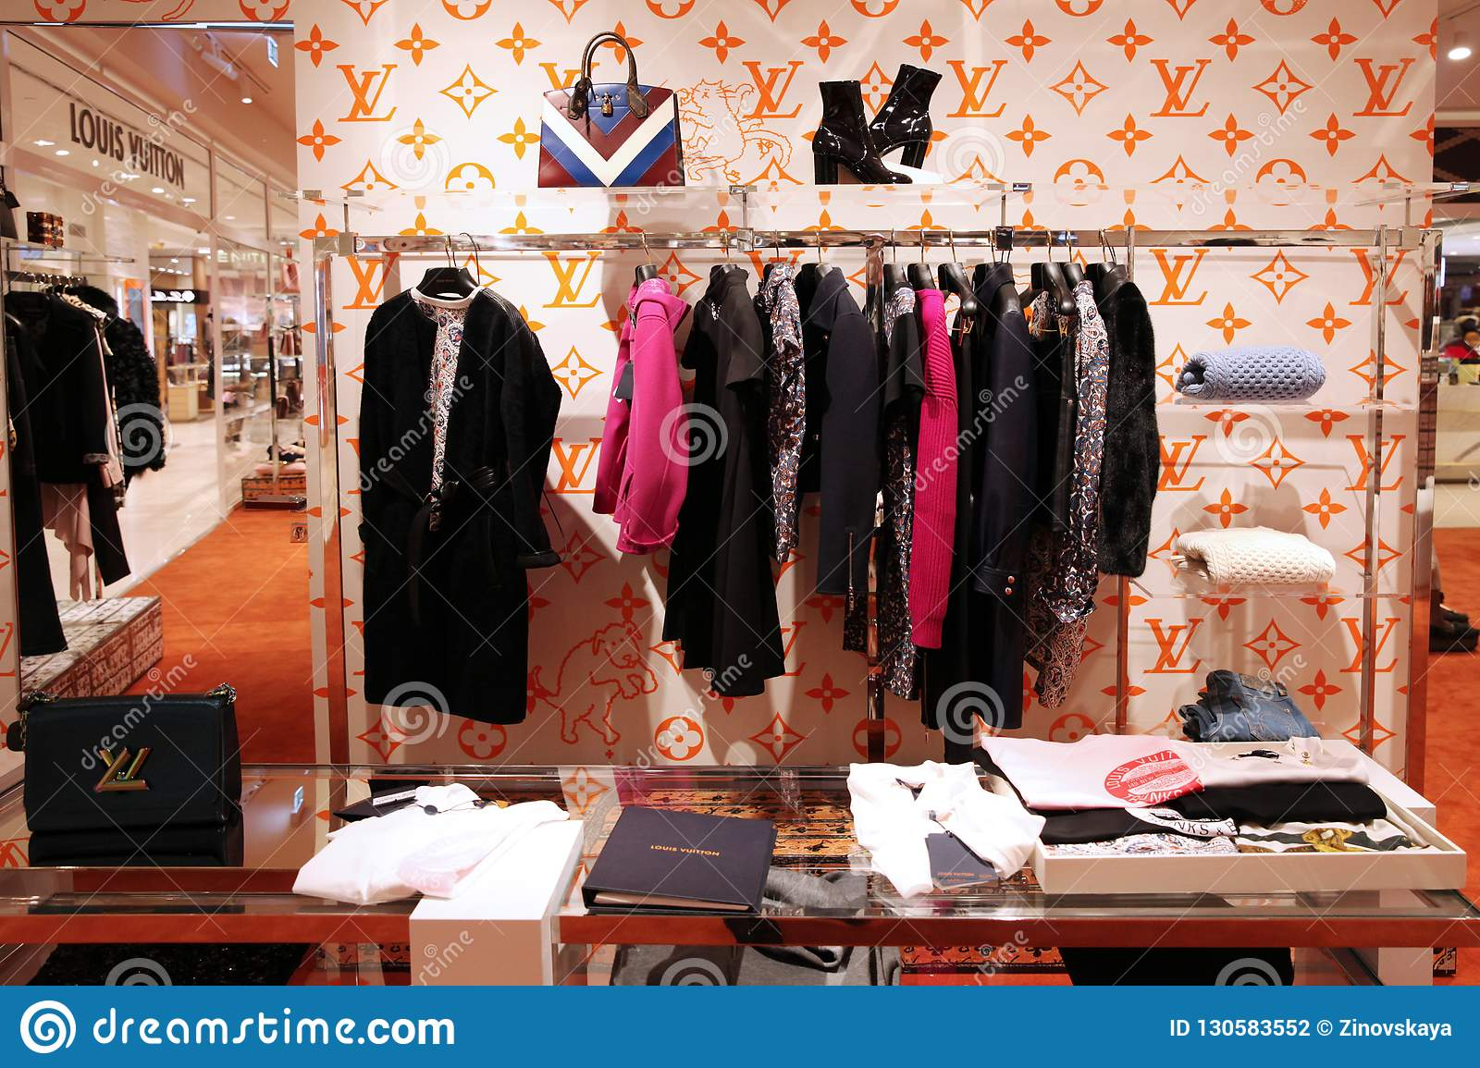
Contain:-
Balance sheet.
Chart.
Buying and Selling.
Strategy.
Road map.
Conclusion

Slide 3
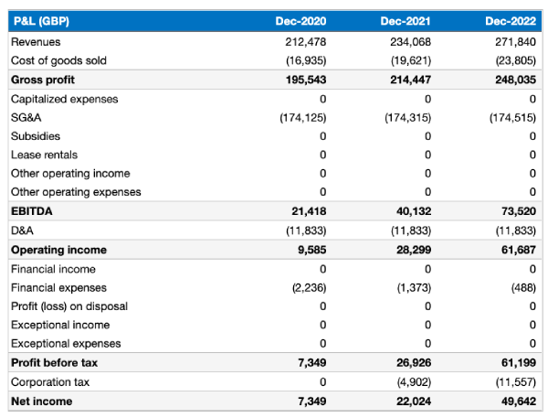
Balance Sheet

Slide 4
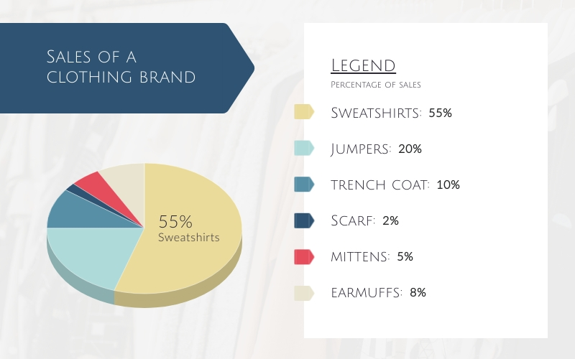
Chart

Slide 5
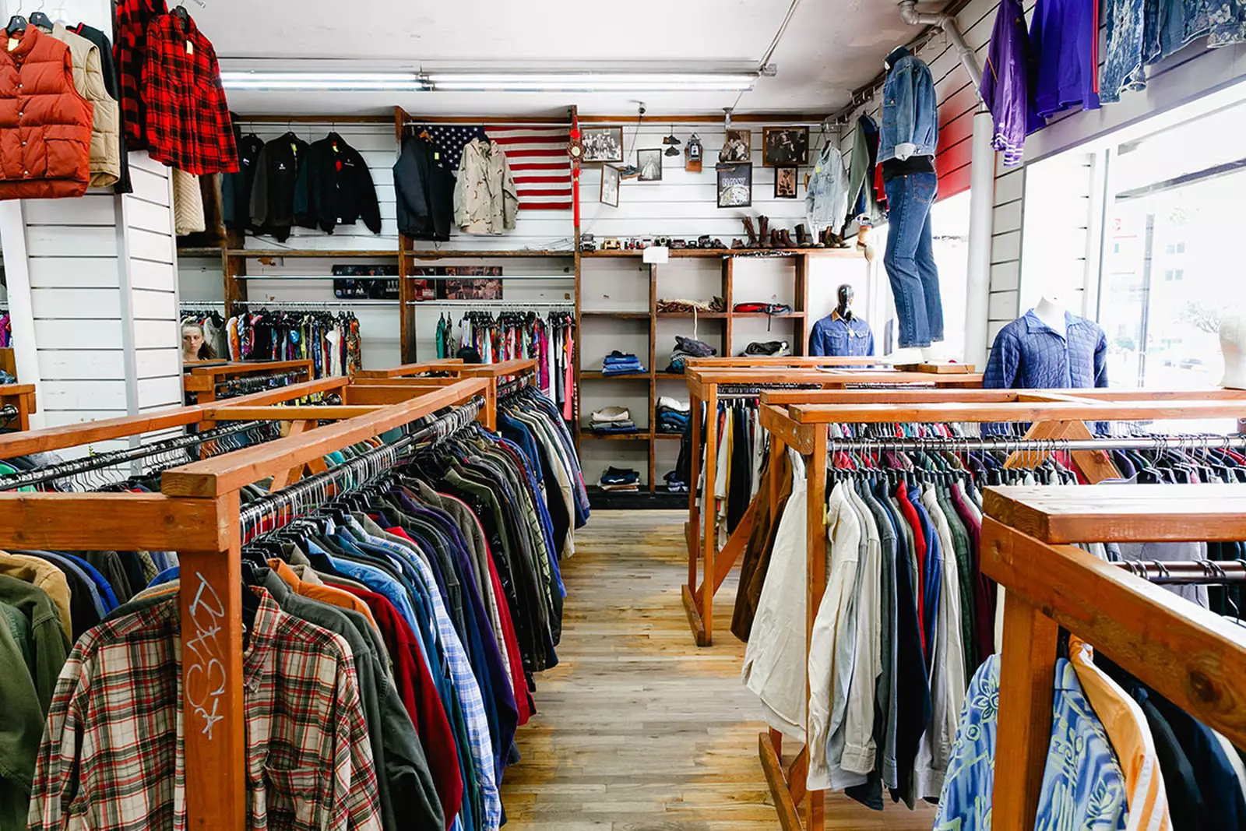
Buying and Selling
TYPES. | BUYING | SELLING | NET PROFIT
T-SHIRT | 10045000 | 20003200 | 9958200
SHIRT | 24555000 | 37500000 | 12945000
FORMAL PANT | 32075000 | 40005000 | 7930000
GEANS PANT | 36082000 | 45007000 | 8925000
FORMAL SHIRT | 28075000 | 36050000 | 7975000
SPORT WEAR | 14560000 | 26005000 | 11445000
Total | 145392000 | 204570200 | 59178200

Slide 6

Strategy
Recognize Your Demographic and Niche. ...
Focus On Your Best Sellers. ...
Regularly Instill FOMO Through Promotions. ...
Create Style Guides and Look Books for Your Brand's Website. ...
TikTok's and Instagram Reels for Fashion Inspiration. ...
Partner With Fashion Bloggers and Influencers

Slide 7
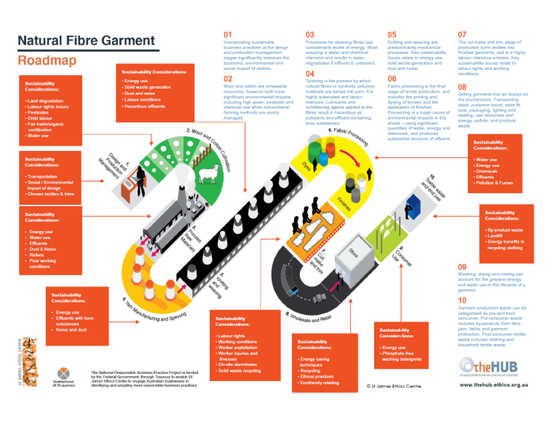
Road map

Slide 8
Conclusion
Fashion interact with several economic, financial, psychological, and sociological factors, which reinforce the importance and need for fashion companies so therefore these business is very profitable because fashioning is becoming very popular style, so people need expensive and fashionable clothes .

